Slide 1
Micro-Credit Defaulter Project
By Rohit kattewar

Slide 2
OUTLINE
Case Study Description
Problem Statement
Data Processing
Data Visualization
Model Building
AUC-ROC Curve
Final Model
Conclusion

Slide 3
Case Study Description
A Microfinance Institution (MFI) is an organization that offers financial services to low income populations. The Microfinance services (MFS) provided by MFI are Group Loans, Agricultural Loans, Individual Business Loans and so on. The MFI industry is primarily focusing on low income families and are very useful in such areas, the implementation of MFS has been uneven with both significant challenges and successes.
It’s crucial to understand the importance of communication and how it affects a person’s life, thus, focusing on providing the services and products of the company to low income families and poor customers that can be helped them in the need of hour.
The Source of this dataset is collaborating with an MFI to provide micro-credit on mobile balances to be paid back in 5 days. The Consumer is believed to be defaulter if he deviates from the path of paying back the loaned amount within the time duration of 5 days. For the loan amount of 5 (in Indonesian Rupiah), payback amount should be 6 (in Indonesian Rupiah), while, for the loan amount of 10 (in Indonesian Rupiah), the payback amount should be 12 (in Indonesian Rupiah).

Slide 4

Problem Statement
The sample data is provided by the source to improve the selection of customers for the credit, the client wants some predictions that could help them in further investment and improvement in selection of customers.
Build a model which can be used to predict in terms of a probability for each loan transaction, whether the customer will be paying back the loaned amount within 5 days of insurance of loan.

Slide 5
Data Processing
Null Values : The dataset has no null values present in it originally.
Unique values and Value count of each column.
Initially the “pdate” column has the ‘Object’ data-type format. So, we need to convert the format into date-time and create the separate columns as “Year”, “Month” and “Date”.
The column “Unnamed 0” and “msisdn” are not relevant to predict anything so we dropped those columns.
After that, we dropped ‘’Year”, “pdate”, “fr_da_rech30”, “maxamnt_loans30”, “pcircle” columns respectively.

Slide 6
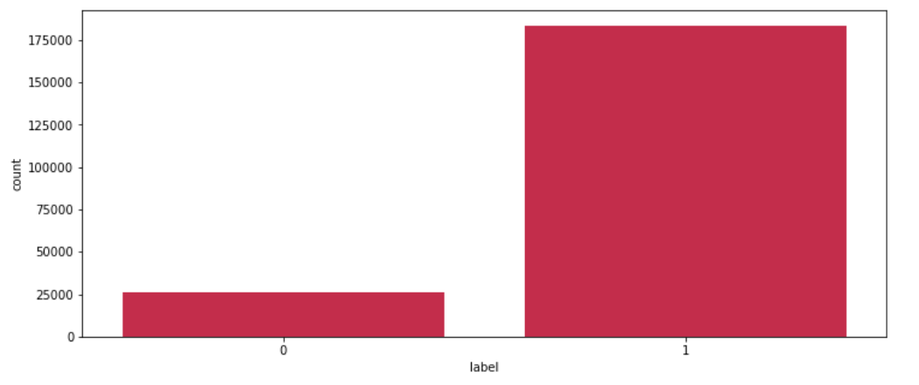
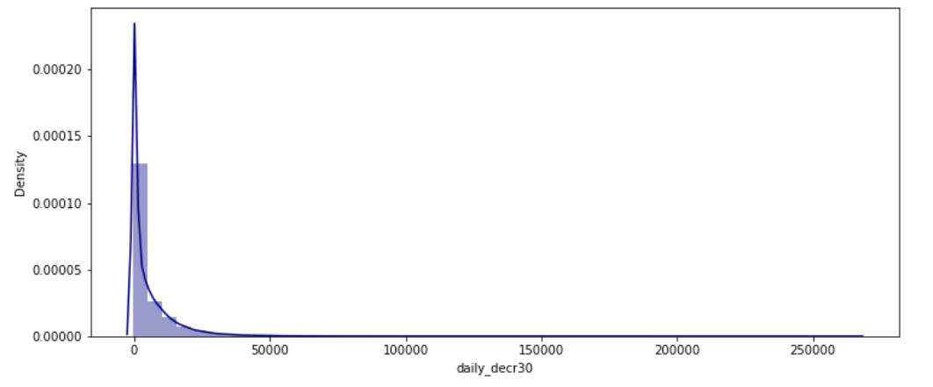
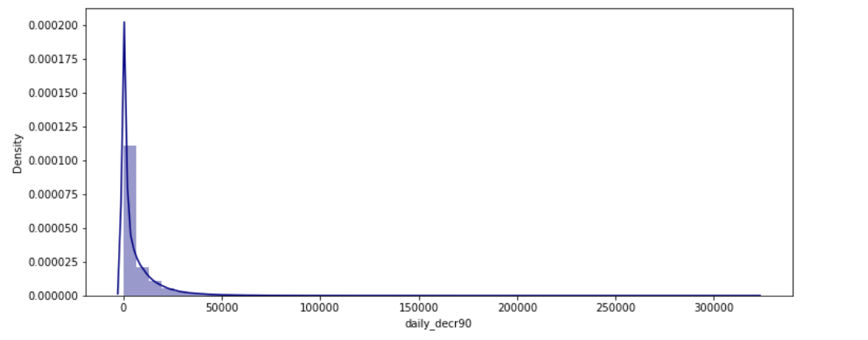
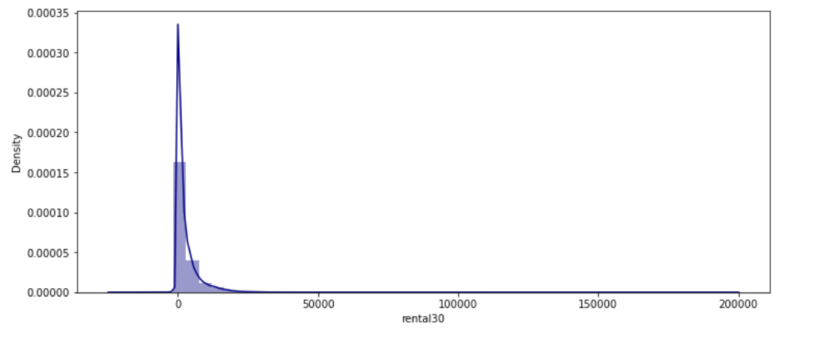
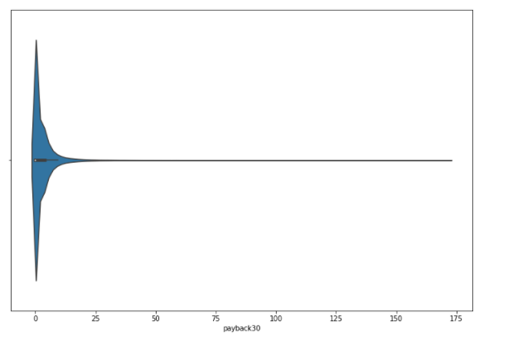
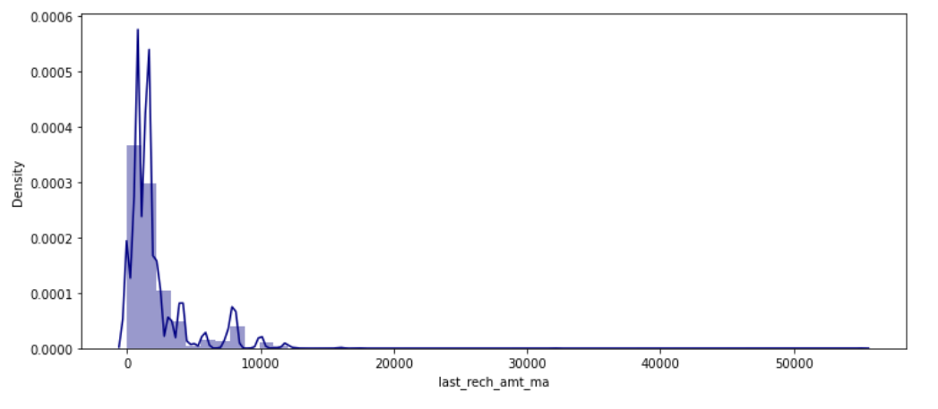
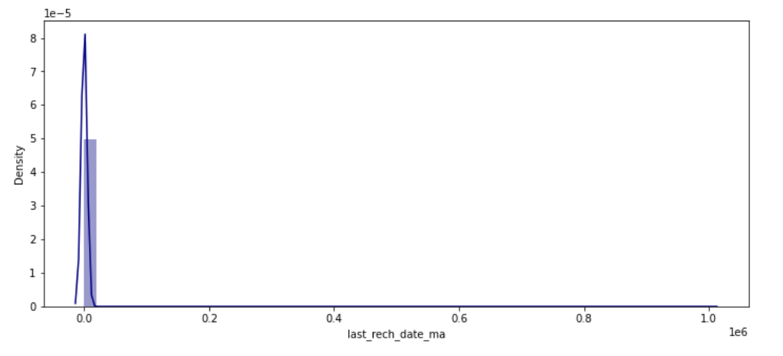
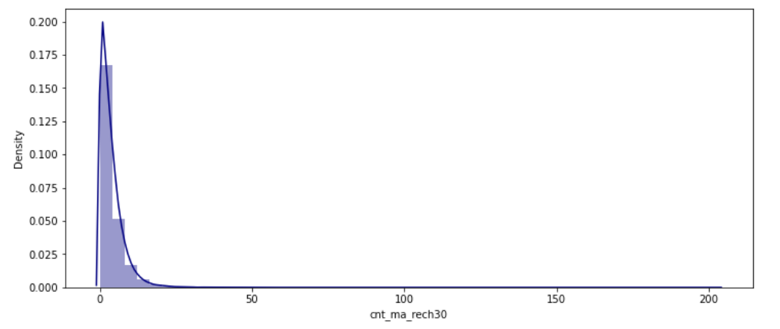
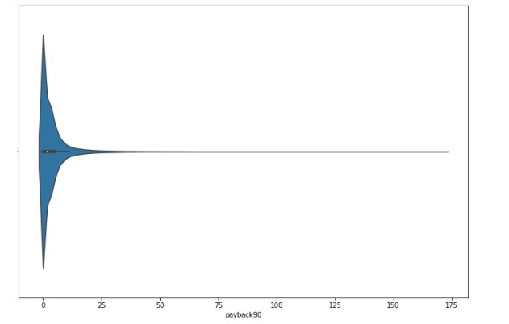

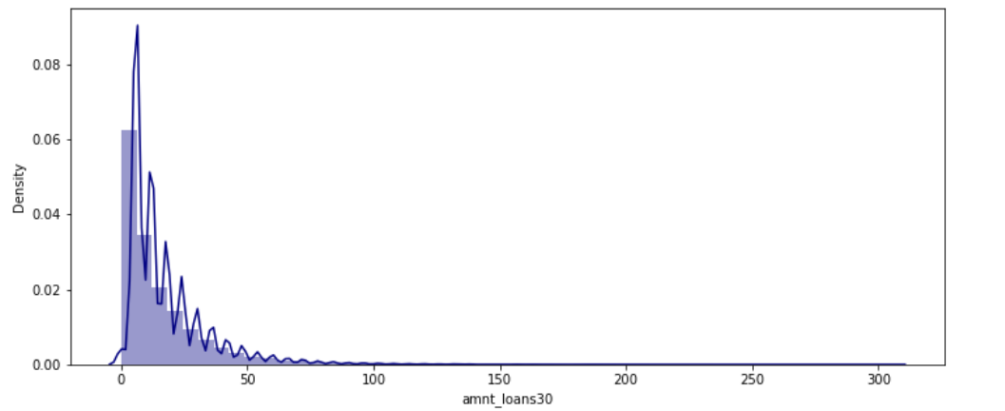
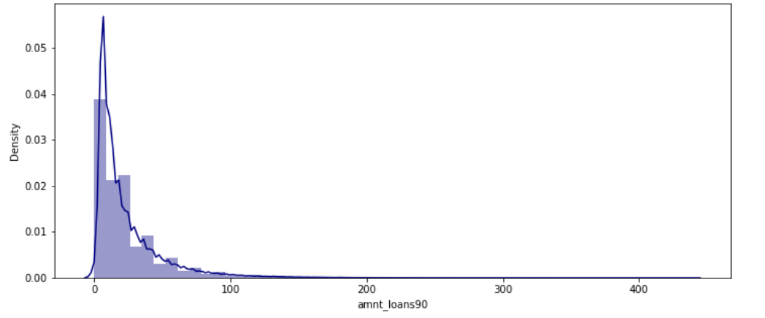
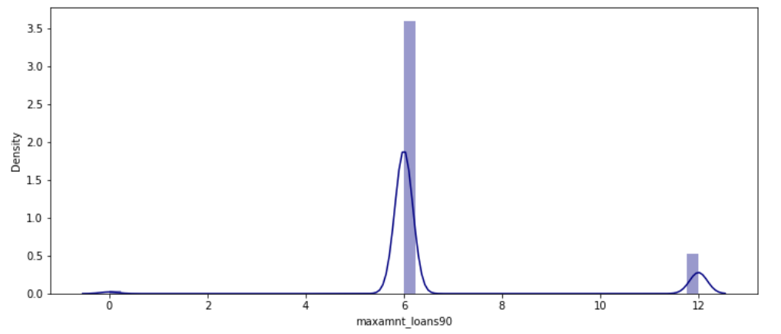
Data visualization

Slide 7
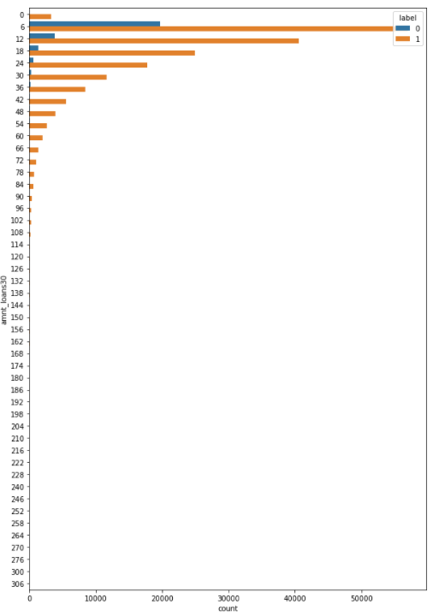
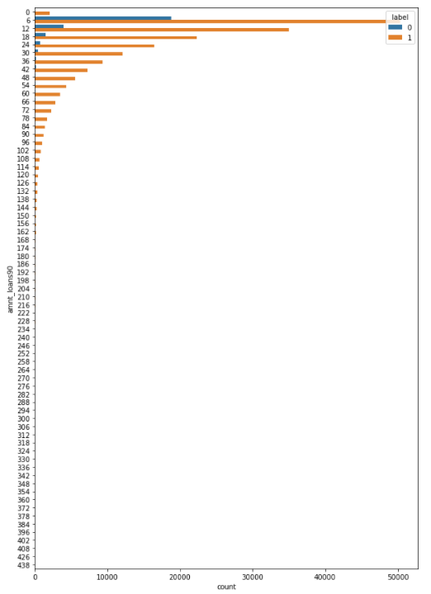
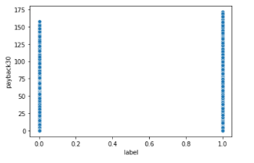
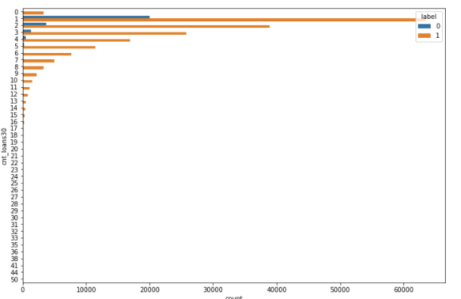
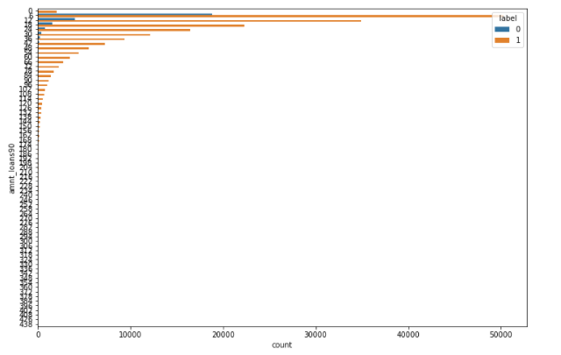
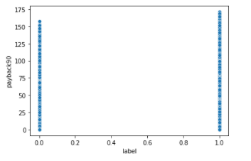
Data visualization

Slide 8
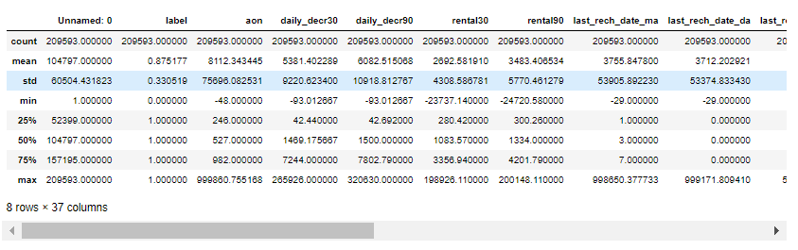
Statistical Summary

Slide 9
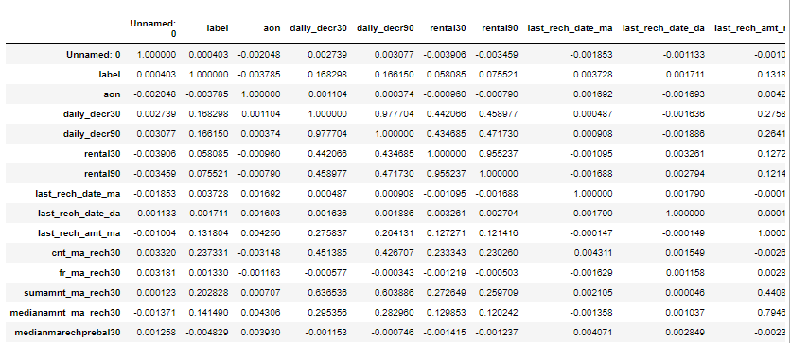
Correlation

Slide 10
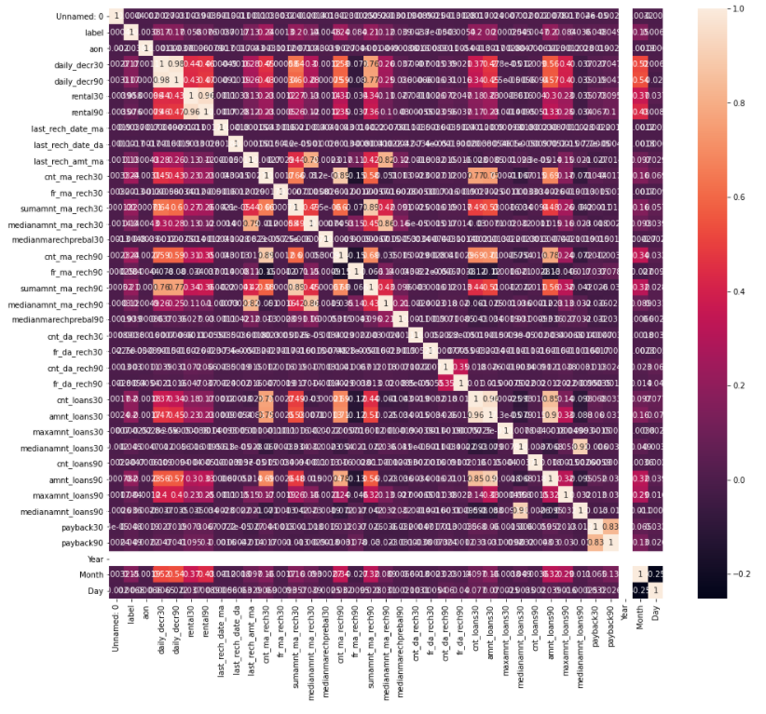
Correlation using Heatmap

Slide 11
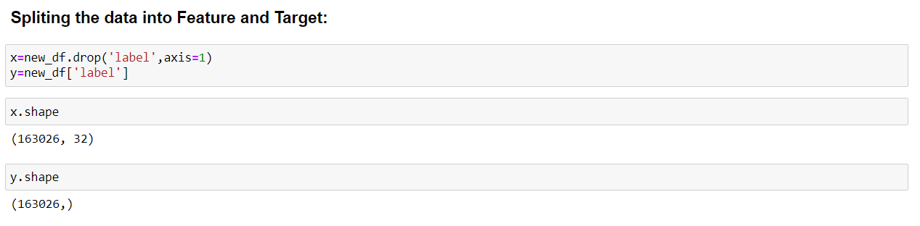
Model Building

Slide 12
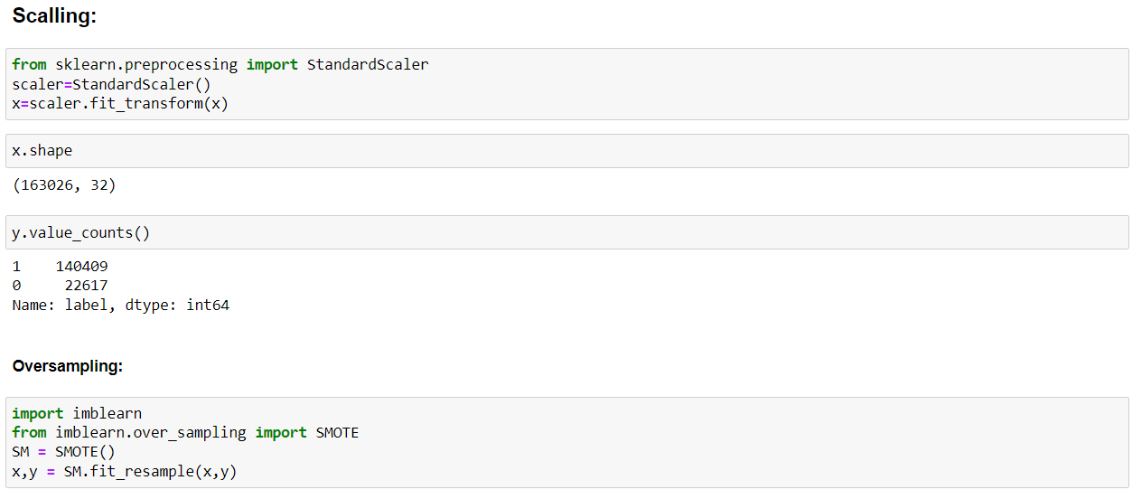
Scalling and Oversampling the x and y

Slide 13
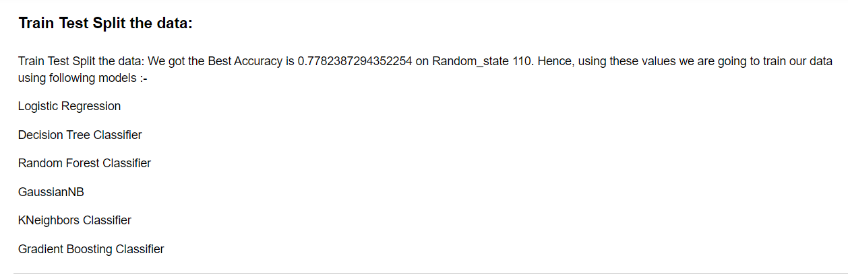
In order to build the model, we will be splitting the train, test and split the data and then train using following models.

Slide 14
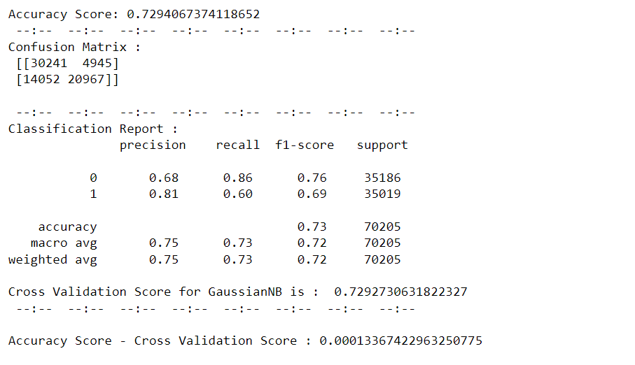
Getting the Accuracy score, Confusion matrix, Classification report and the Cross Validation score for the GaussianNB model.

Slide 15
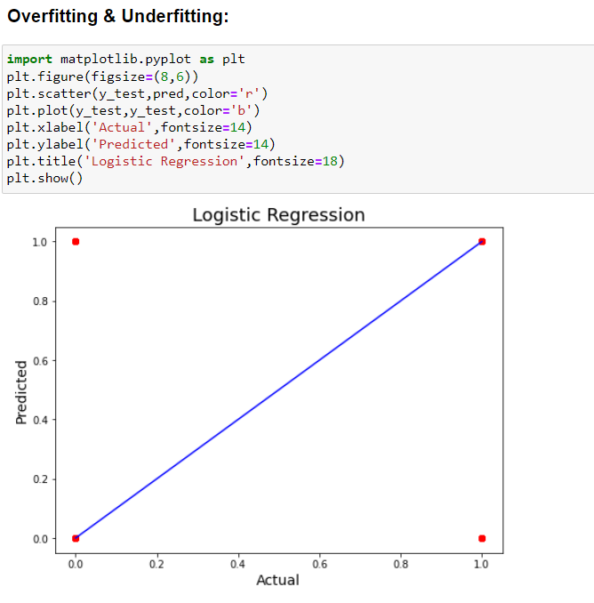

Slide 16
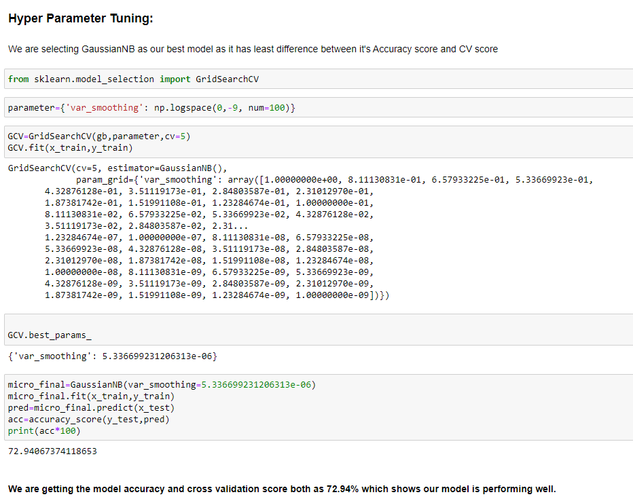
Model Performance

Slide 17
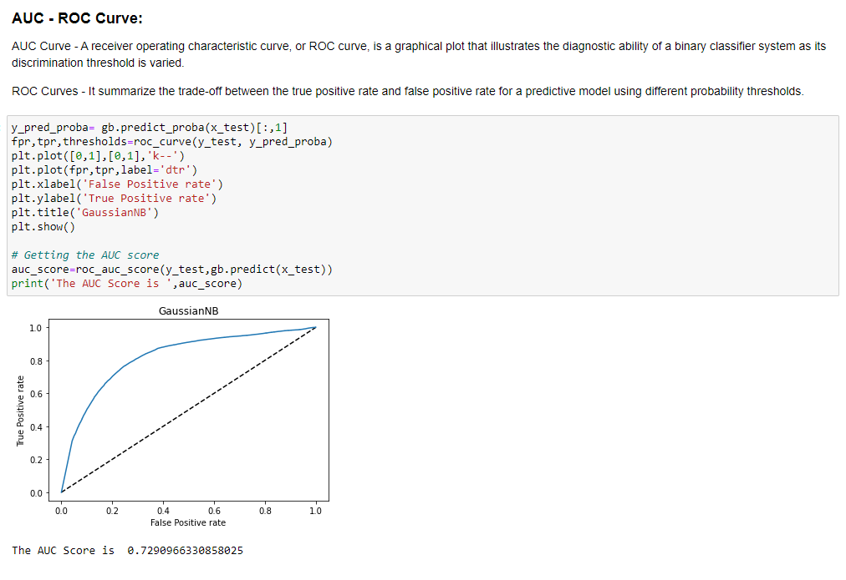
AUC-ROC Curve

Slide 18
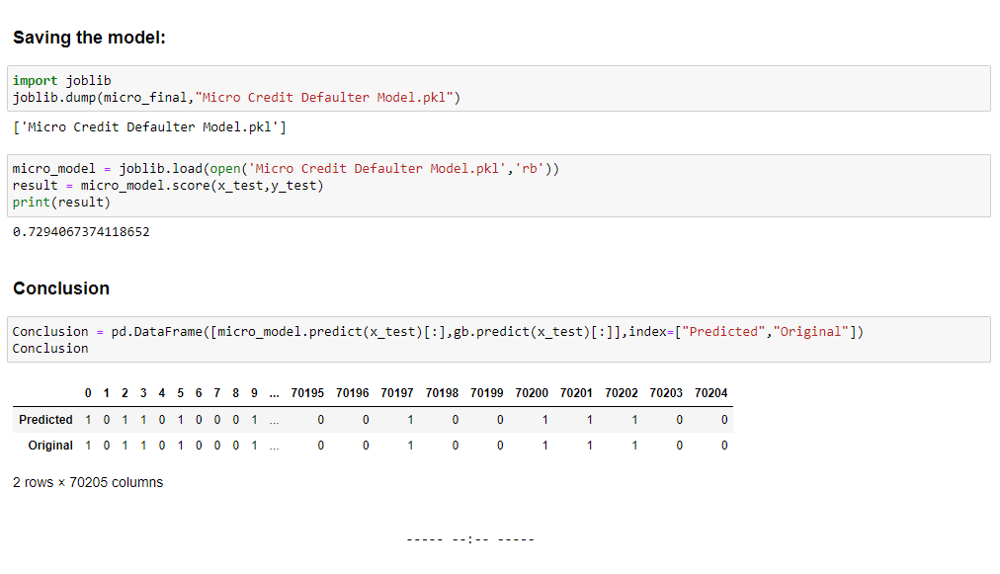
Conclusion

Slide 19

thank you

